Slide 1




SmartSolar: Predicting Solar Panel Output and Battery Backup Time Using Machine Learning

Slide 2
Presented By
Name:
Mishal Ibna Mashud
Mohammad Sadiullah Ishmam Md Nasibul Islam Sazid
Syeda Sayma Sultana
ID:
2022-3-60-053
2022-3-60-136
2022-3-60-014
2022-3-60-128
16 April 2026

Slide 3
Introduction and Project Definition
Project Definition: An end-to-end Machine Learning pipeline and web application designed to forecast usable solar energy output and battery backup duration.
Our Approach: Bridging domain knowledge and AI. We augmented traditional physics-based solar equations with advanced Machine Learning models to capture complex weather interactions.
The Final Deliverable: An interactive, user-friendly Streamlit dashboard that turns raw meteorological data into actionable energy insights.

Slide 4


The Real-World Problem in Bangladesh
The Local Context: Frequent grid instability (load-shedding) makes reliable battery backup an absolute necessity, not a luxury.
The Weather Challenge:
  Monsoon Season: Heavy, unpredictable cloud cover drastically reduces solar irradiance.
  High Heat & Humidity: Extreme summer temperatures negatively impact solar panel efficiency.
The Core Gap: Traditional mathematical formulas cannot accurately predict how long a battery will last under these extreme, dynamic tropical weather conditions.

Slide 5

Current Situation in Bangladesh
1. The Energy Reliability Gap
Persistent Load-Shedding: Despite increased generation capacity, urban and rural areas in Bangladesh still face unpredictable power outages due to fuel supply volatility and grid instability.
Dependency on Fossil Fuels: Over 70% of the national grid remains dependent on natural gas and imported coal, leading to high costs and energy insecurity.

Slide 6
Current Situation in Bangladesh
2. The Solar Integration Challenge
Intermittency Issues: Solar Home Systems (SHS) and industrial rooftop solar are expanding, but power generation fluctuates wildly due to monsoon cloud cover and high humidity.
Lack of Predictive Tools: Most current users have no way to know how much "backup" they actually have, leading to unexpected shutdowns of critical appliances during outages.

Slide 7
Current Situation in Bangladesh
3. Technical Shortcomings
Static Estimation: Existing battery management systems use "fixed formulas" that don't account for real-time weather changes or panel degradation in tropical heat.
Data-Action Gap: There is a massive amount of solar data being generated, but it isn't being used to provide real-time, actionable insights for the average consumer.

Slide 8

Research Questions
Weather Impact Analysis: How do dynamic, extreme tropical weather patterns (e.g., monsoon cloud cover and high summer heat) quantitatively impact solar panel efficiency in Bangladesh compared to theoretical baselines?
Machine Learning vs. Traditional Models: To what extent do advanced ensemble ML models (like LightGBM and Random Forest) outperform static mathematical formulas in forecasting solar generation under unpredictable weather conditions?
Actionable Resilience: How can predicted solar generation be accurately converted into reliable battery backup duration to help end-users mitigate the effects of frequent load-shedding?

Slide 9
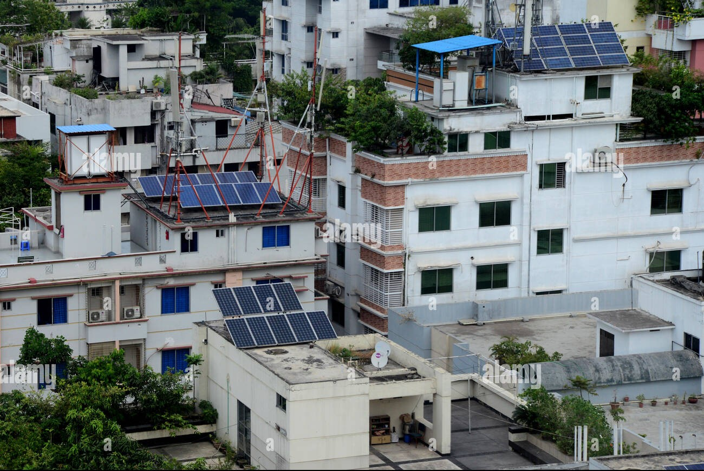
Project Objectives
Objective 1: Performance Benchmarking of ML Algorithms
  To evaluate and compare the predictive accuracy of five machine learning models in forecasting solar irradiance specifically within the tropical climatic conditions of Bangladesh.
Objective 2: Development of a Hybrid Prediction Framework
  To design a hybrid system that integrates traditional Photovoltaic (PV) physics equations with real-time ML data to minimize error margins caused by volatile weather patterns like monsoon cloud cover.
Objective 3: Implementation of a User-Centric Decision Tool
  To deploy an interactive Streamlit dashboard that translates complex energy predictions into actionable insights, specifically calculating real-time battery backup duration to help users mitigate the impact of load-shedding.

Slide 10
Literature Review
Authors & Year | Title | Main Idea | Methodology | Key Findings | Limitations
S.-G. Kim, J.-Y. Jung, M.K. Sim (2019) | A Two-Step Approach to Solar Power Generation Prediction Based on Weather Data Using Machine Learning | Proposes a two-step approach that identifies latent auxiliary variables before predicting power | Evaluated AdaBoost, Linear Regression, CART, SVR, ANN, k-NN, and Random Forest (RF) using a backward elimination feature selection | The two-step approach improved accuracy regardless of the algorithm used, with Random Forest yielding the best overall performance | Indirectly investigates algorithmic benefits; restricted to South Korean plant data without broader geographic testing.
T.O. Falope et al. (2024) | A Three-Step Weather Data Approach in Solar Energy Prediction... | Explores a unique three-step model combining multiple weather data sources using Low-Level Data Fusion (LLDF) and Pearson correlation | Compared Boosted Trees, SVM, GPR, and Neural Networks across scenarios integrating on-site and local weather station data | Fusing data from both on-site and local stations via LLDF significantly outperformed single-station models, with Boosted Trees being the most accurate | Requires both local and on-site stations to measure reference parameters; limited strictly to UK data and positive correlations

Slide 11
Literature Review
M. Abdel-Nasser, K. Mahmoud (2017) | Accurate photovoltaic power forecasting models using deep LSTM-RNN | Utilizes Long Short-Term Memory (LSTM) deep recurrent networks to handle temporal changes in PV power | Compared 5 different LSTM architectures against Multiple Linear Regression (MLR), Bagged Regression Trees (BRT), and standard Neural Networks. | The proposed LSTM method accurately predicted PV power and heavily outperformed MLR, BRT, and traditional NN models. | Did not study the effect of data outliers and excluded key environmental parameters like temperature.
S. Leva, A. Dolara, F. Grimaccia, M. Mussetta, E. Ogliari (2015) | Analysis and validation of 24 hours ahead neural network forecasting of photovoltaic output power | Presents an Artificial Neural Network (ANN) model specifically tuned for 24-hour ahead PV power forecasting coupled with a clear sky model. | Applied an ANN (trained on 240 days of data) and evaluated point-wise relative errors against measured power output. | The hourly ensemble error based on the predicted power was consistently smaller than individual trial errors, validating it for day-ahead forecasting. | Generates particularly high prediction errors on fully cloudy days, making variable conditions a weakness.

Slide 12

Project Stakeholders
1. Primary Stakeholders (Direct Users)
Residential Solar Home System (SHS) Users: Homeowners in rural areas and urban who need to know exactly how many hours of battery backup they have during load-shedding.
Industrial & Commercial Entities: Small to medium enterprises (SMEs) that rely on rooftop solar to maintain productivity during grid failures.
2. Institutional & Academic Stakeholders
East West University (EWU): As the primary data provider, the university benefits from the research findings to optimize their own on-campus solar energy management.
Research & Academic Community: Future students and researchers in Bangladesh can use this hybrid ML-Physics framework as a foundation for renewable energy studies.

Slide 13
Data Collection
1. Primary Source: Ground-Truth Data
Location: East West University (EWU) Campus, Aftabnagar, Dhaka.
Data Type: Real-time solar irradiance and power generation logs from the university's solar installation.
Significance: Provides high-resolution, localized data that reflects the specific micro-climate and urban pollution levels of Dhaka.

Slide 14
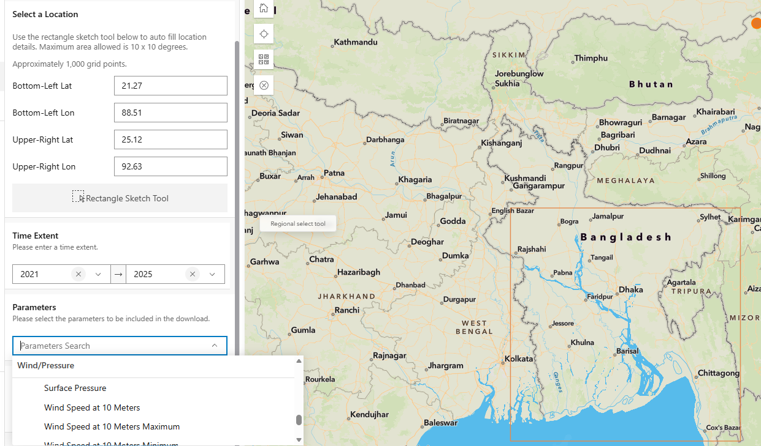
Data Collection
2. Secondary Source: NASA POWER API
Data Type: Meteorological and Solar Estimation data.
Parameters Retrieved:
  All-Sky Surface Shortwave Downward Irradiance
  Air Temperature at 2 Meters
  Relative Humidity
  Precipitation (Rainfall)
  Wind Speed & Direction
.

Slide 15
Methodology
1. Data Gathering
Local: Solar logs from East West University (EWU).
Global: Weather data from NASA POWER.
2. Data "Cleaning"
Fixed missing data and removed "noise" (errors).
Synced the two datasets together by time and date.

Slide 16
Methodology
3. The "AI Battle" (5 Models)
We tested 5 different AI "brains" to see which predicts solar power best:
ANN (Artificial Neural Network)
XGBoost (Fast & Powerful)
LightGBM (Efficient)
CatBoost (Smart with weather categories)
Gradient Boosting (Reliable baseline)
4. Result: Smart Backup Tool
Pick the best model.
Link it to a Streamlit Dashboard.
Calculate exactly how many hours of battery and the output backup power.

Slide 17
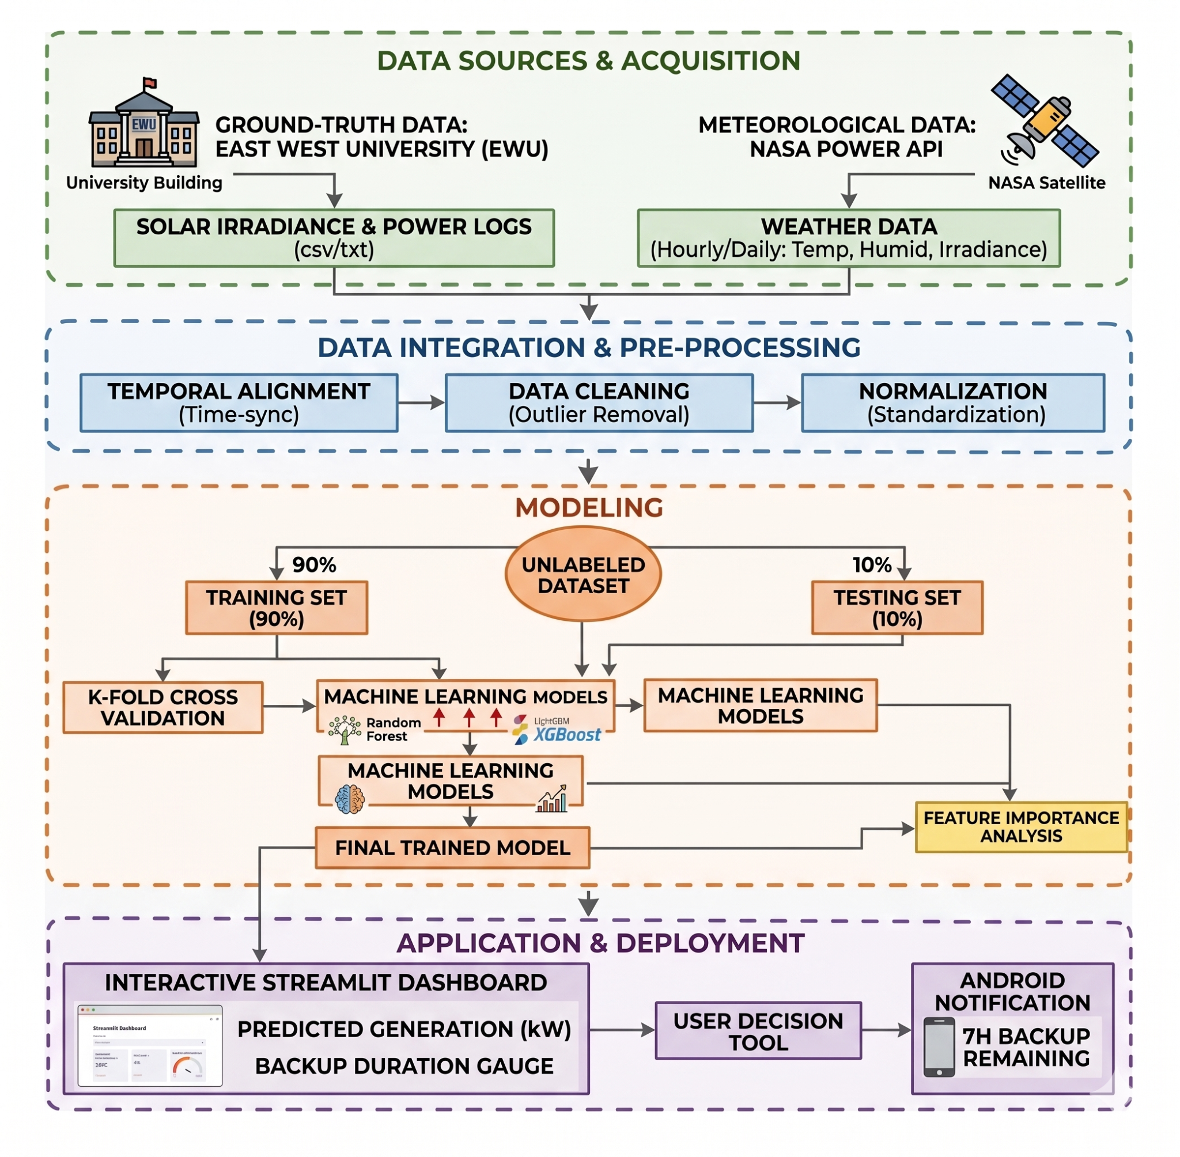
Methodology

Slide 18
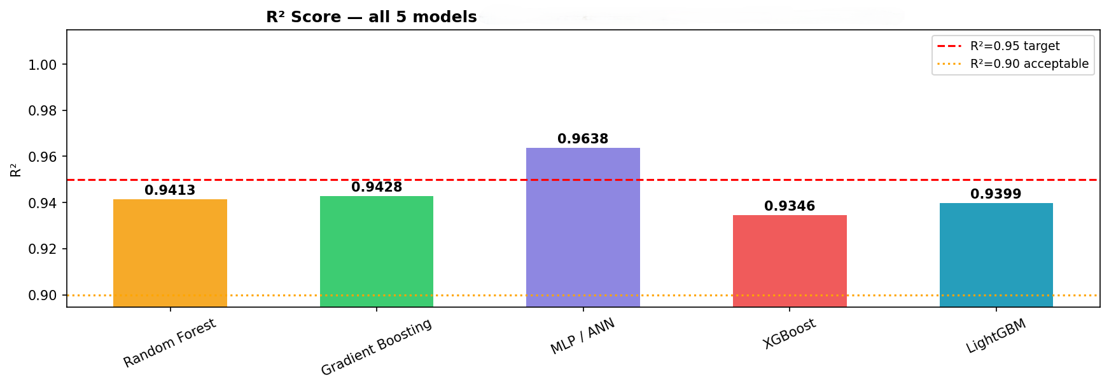
Methodology

Slide 19
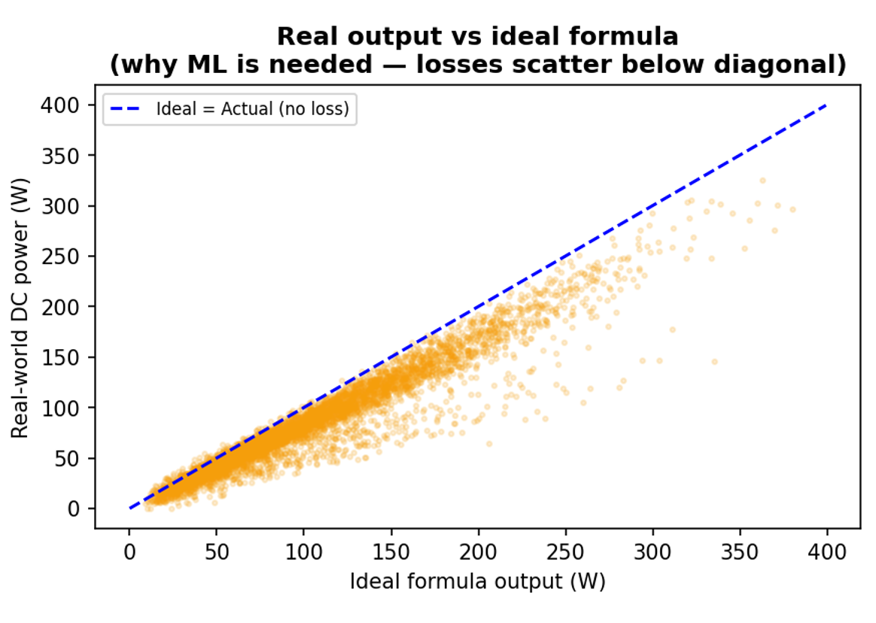
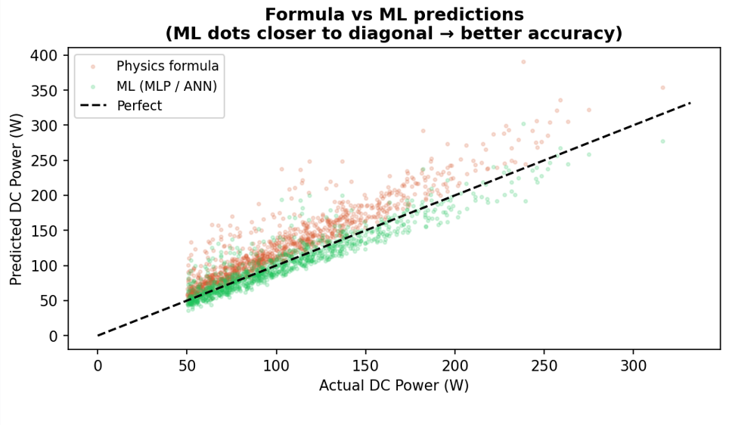
Methodology

Slide 20
Applications
SmartSolar Dashboard Summary:
Core Purpose: ML-driven dashboard predicting real-world solar output and battery runtime.
Current Predictions: Adjusted output and projected backup runtime at specific work load.
Loss Tracking: Quantifies real-world losses (e.g., soiling -5%, aging -3%) to bridge the gap between ideal (306 W) and actual performance.
Model Accuracy: Uses an "ML Ensemble" prediction by benchmarking algorithms like XGBoost and Random Forest.
Storage Calculation: Visually combines daily solar generation and usable battery capacity for total available power

Slide 21
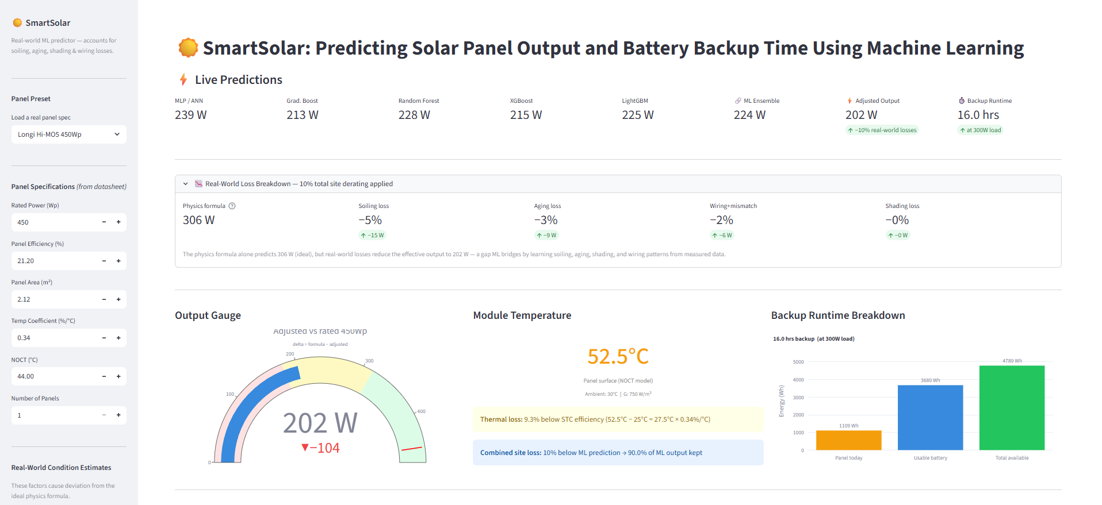
Applications

Slide 22
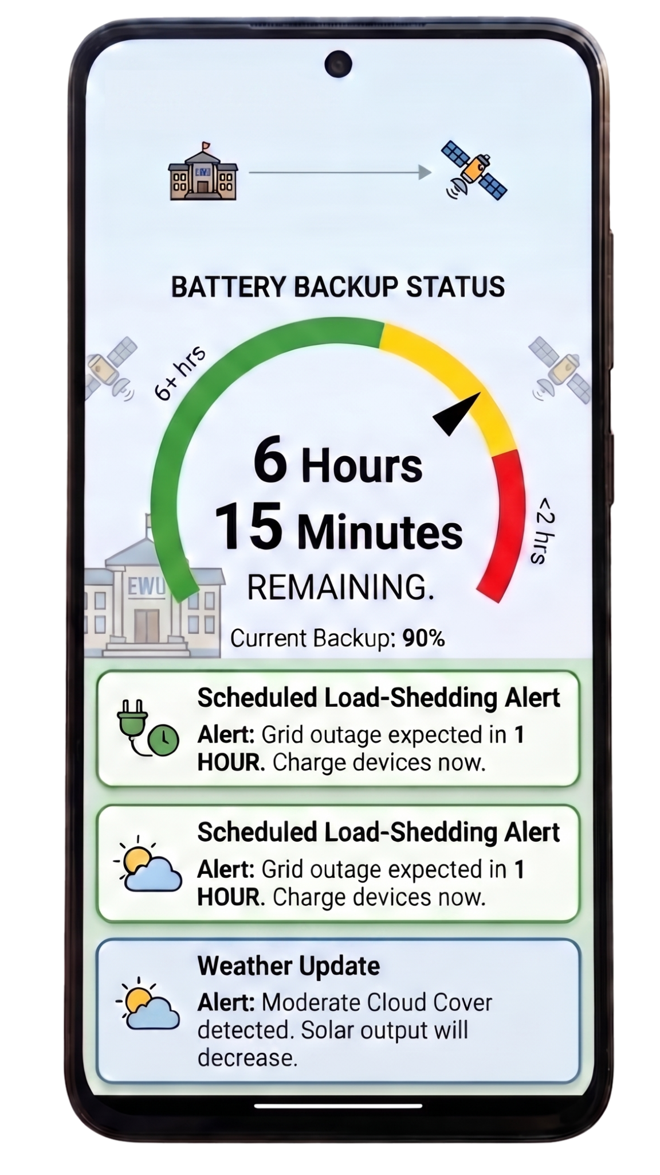
Future Scopes
1. Real-Time Smart Dashboard
Live Energy Monitoring: View current solar generation and battery levels at a glance through a clean Android interface.
Predictive Countdown: Replaces complex charts with a simple, actionable timer: "5 Hours and 20 Minutes of Backup Remaining."
2. Intelligent Alert System
Load-Shedding Prep: Sends proactive notifications before scheduled outages, advising users to optimize energy storage.
Dynamic Weather Alerts: Real-time warnings for sudden environmental changes (e.g., "Cloud cover detected; solar output will decrease").
3. Personalized Energy Insights
Daily Performance Reports: Visual summaries of energy saved and battery health over the last 24 hours.
Efficiency Recommendations: Smart tips to extend backup life, such as: "Battery at 40%; please delay high-load appliance use."

Slide 23
Conclusion
To wrap things up, this project shows how AI can actually help solve the everyday problem of power cuts in Bangladesh. By combining real solar data from our own East West University campus with NASA's weather tracking, we tested five different AI models to find the absolute best way to predict solar power during unpredictable monsoon weather. The final result of all this testing is the 'SolarPredict' app. This app does the hard math behind the scenes and gives people exactly what they need: a simple countdown timer showing how much battery backup they have left. Ultimately, this project takes high-level data science and turns it into a practical, everyday tool that helps families manage their energy and handle load-shedding with confidence.

Slide 24
Q/A

Slide 25
Thank you!

